Slide 1
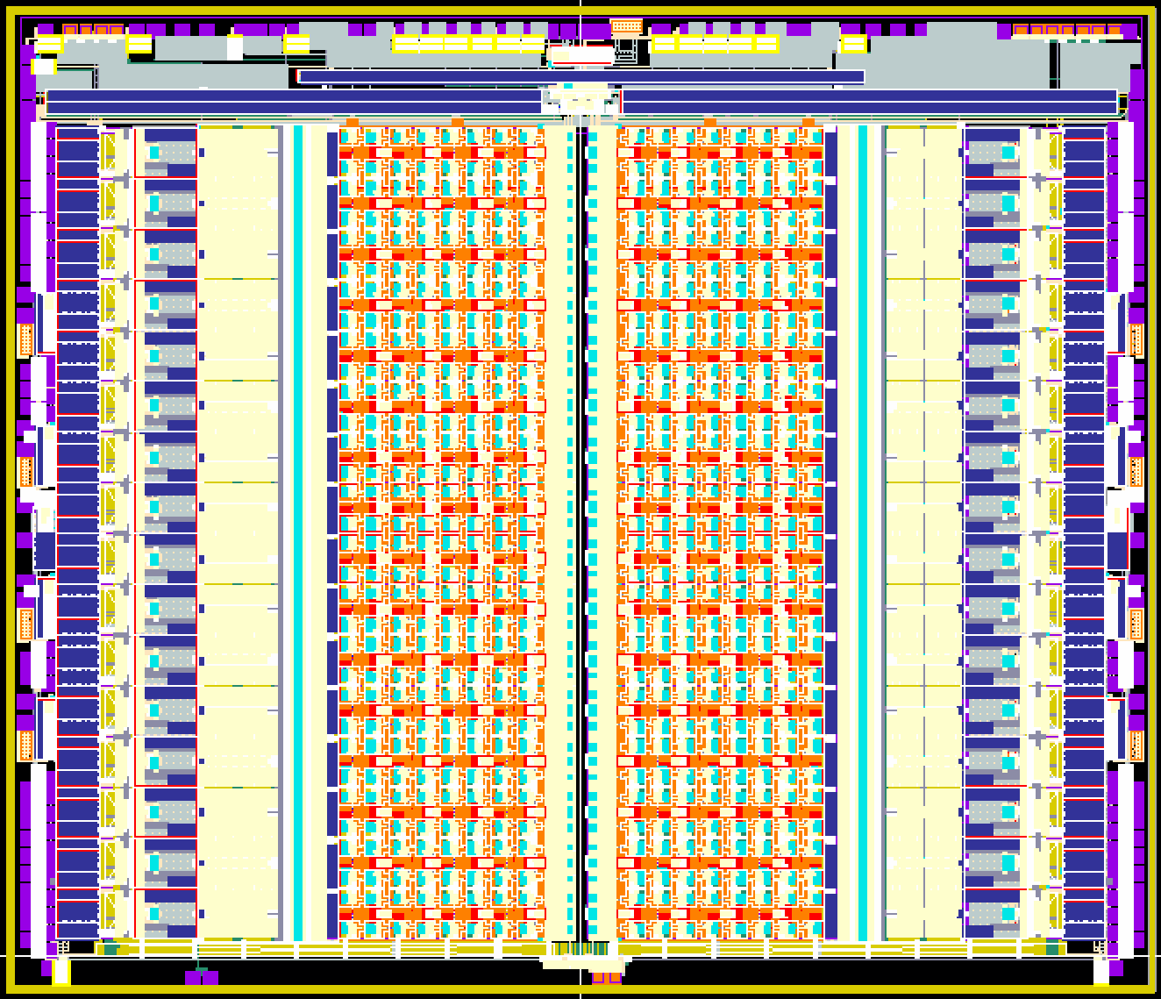
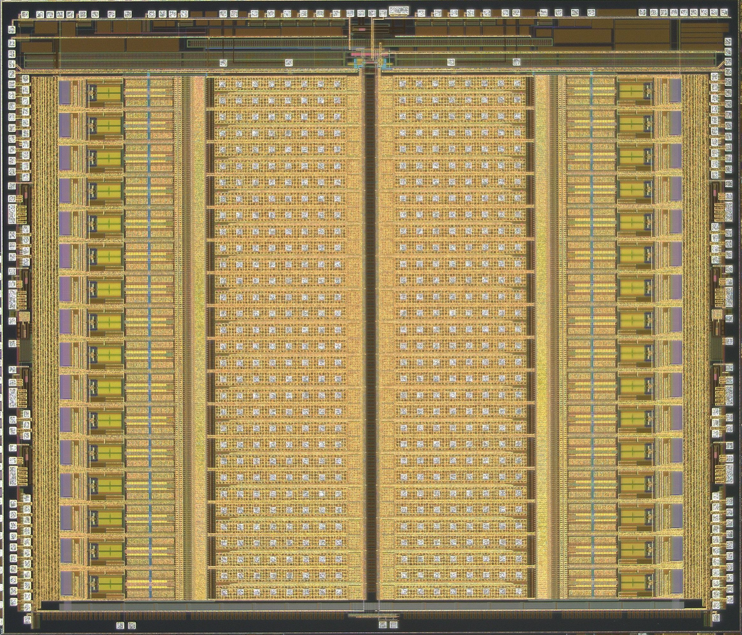
ASIC Layout
PGA BUFFER
SAR ADCs
512 Recording Pixels
128/512 Stimulating
PGA BUFFER
SAR ADCs
7mm
7mm
8.1 mm
8.1 mm

Slide 2
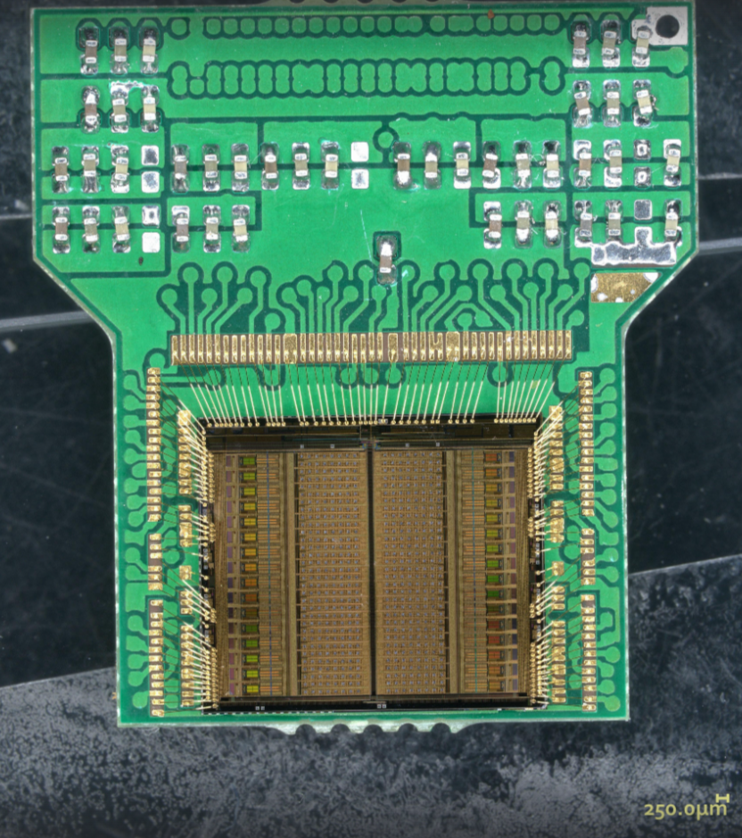
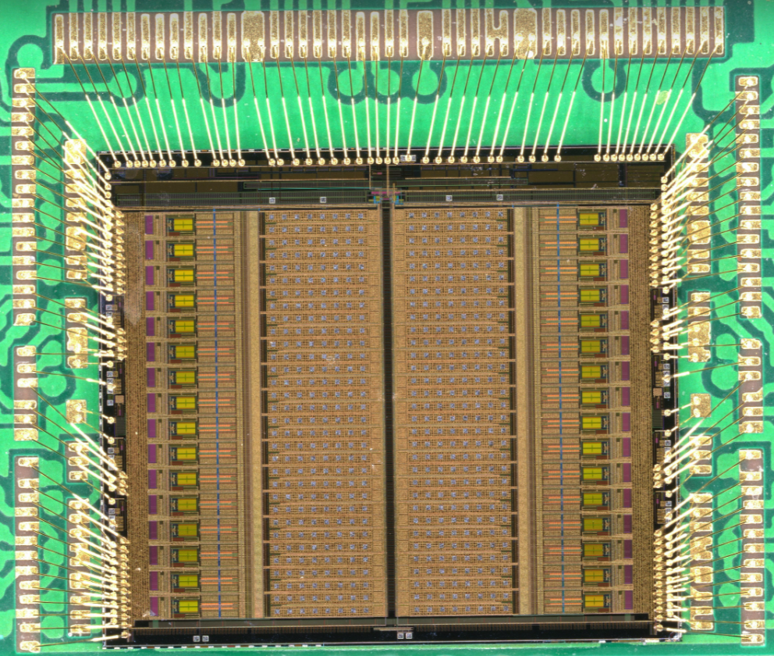
Bonding Map
Bonding recipe for the ASIC-board connection

Slide 3
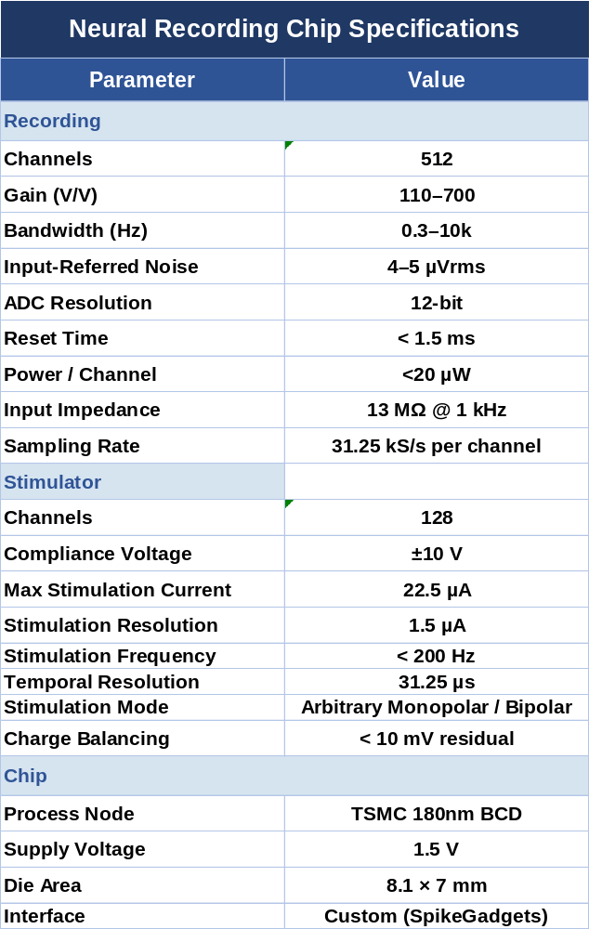

Chip Specifications
Gain
  Programmable 3bits: (110 – 700)
  Raw data bandwidth: (0.3Hz – 10kHz)
  Input Referred Noise: (4 – 5uVrms)
  Sampling rate: (31.25kS/s)
Stimulator
  128 channels: Compliance of +/-10V
  Resolution: 1.5uA
  Maximum Current: 22.5uA

Slide 4
Chip Specifications
Gain
  Programmable 3bits: (110 – 700)
  Raw data bandwidth: (0.3Hz – 10kHz)
  Input Referred Noise: (4 – 5uVrms)
  Sampling rate: (31.25kS/s)
Stimulator
  128 channels: Compliance of +/-10V
  Resolution: 1.5uA
  Maximum Current: 22.5uA

Slide 5

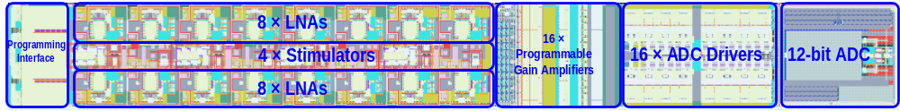
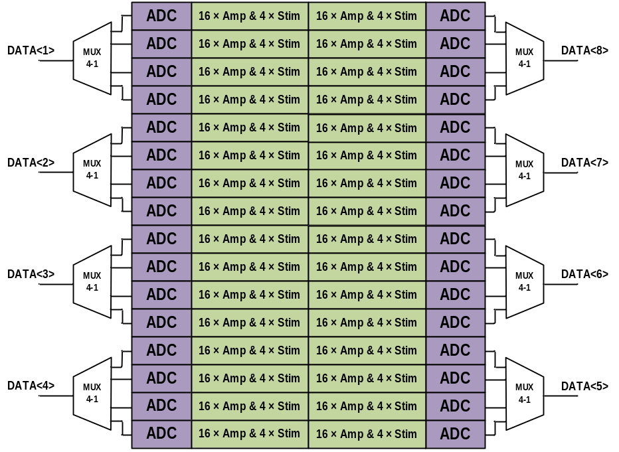
Recording and Stimulation
360µn
3.2 mm
Modular concept
  One module: 16 amplifiers + 4 stimulators
  Arrange 32 copies to make it 512 recording + 128 stimulators
  Programming interface programs the stimulators and the amplifiers
  The ADCs are multiplexed to 8 data lines

Slide 6
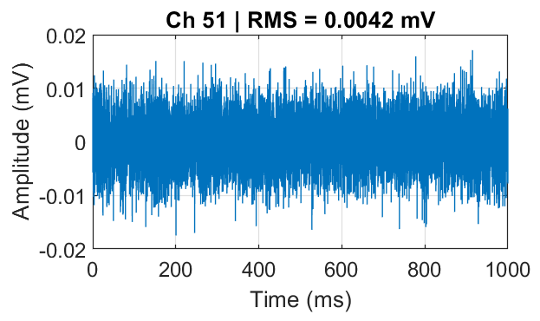
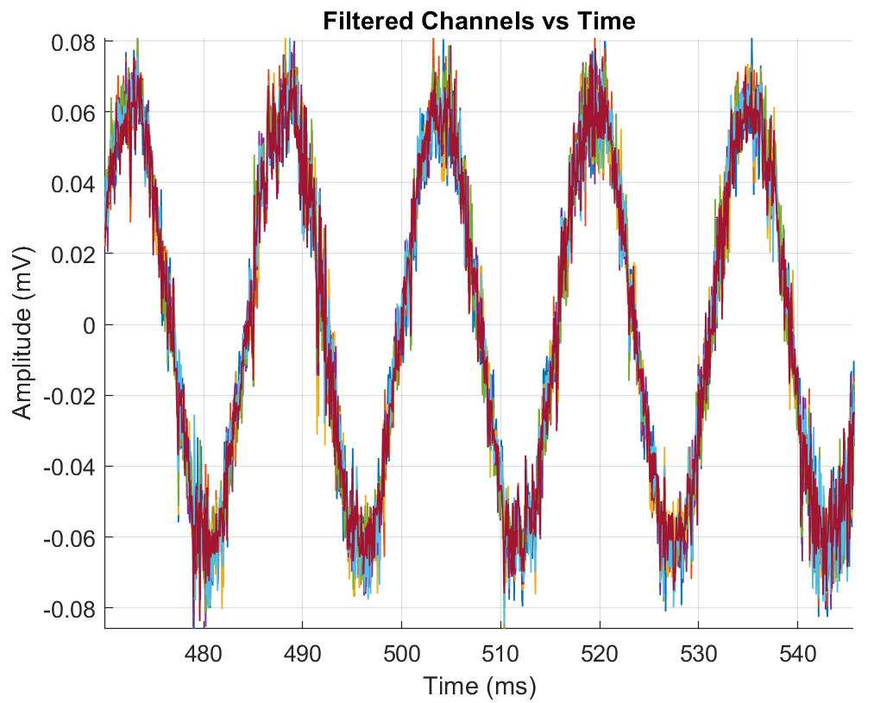
Recording Mode
360µn
3.2 mm
From Pixel Input to ADC Output
  Gain: 100 – 700 (V/V)
  Bandwidth: ~0.3 Hz to 10 kHz
  IRN = 4 – 5 µVrms
  Sampling Rate: 31.25 kS/s per channel
IRN (Input-Referred Noise): ~4.2 µVrms

Slide 7
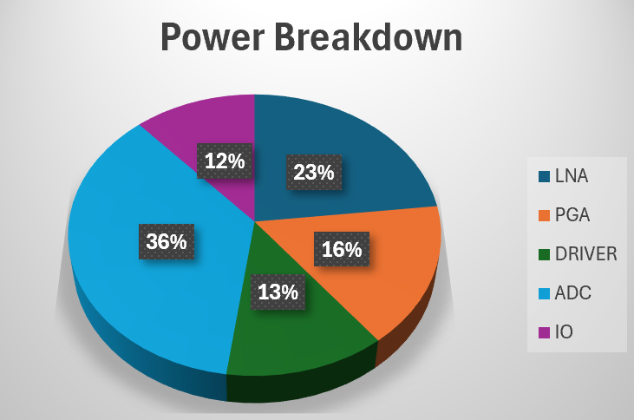
Recording Mode
360µn
3.2 mm
From Pixel Input to ADC Output
  Gain: 100 – 700 (V/V)
  Bandwidth: ~0.3 Hz to 10 kHz
  IRN = 4 – 5 µVrms
  Sampling Rate: 31.25 kS/s per channel
  DC Power: ~17.24 µW / channel
    Not including the external LDOs

Slide 8
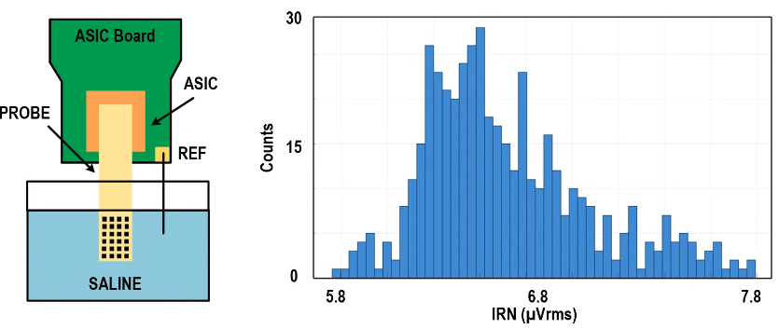
Recording Mode
Integrated ASIC + Probe noise
µ = 6.5µVRMS and σ = 0.3µVRMS

Slide 9
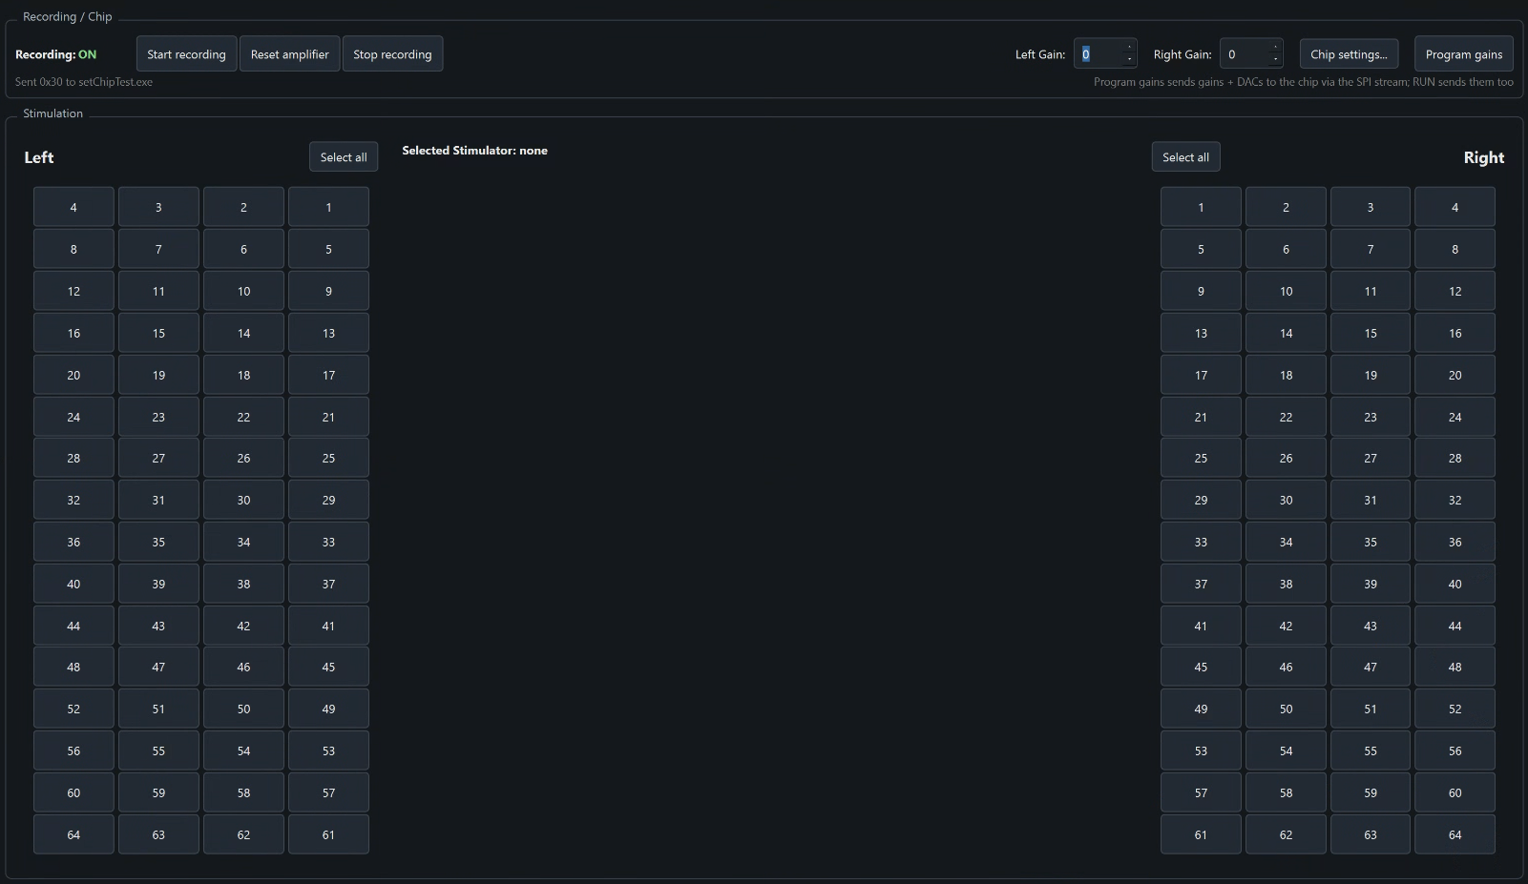
Reading Mode – How?
Custom GUI
  Recording on the top
  Stimulation on the bottom

Slide 10
Reading Mode – How?
Custom GUI
  Recording on the top
  Stimulation on the bottom
Start recording
  Sends a sequence to FPGA to trigger the recording

Slide 11
Reading Mode – How?
Custom GUI
  Recording on the top
  Stimulation on the bottom
Start recording
  Sends a sequence to FPGA to trigger the recording
Reset amplifier
  It sends a sequence to FPGA to trigger the reset the amplifiers

Slide 12
Reading Mode – How?
Custom GUI
  Recording on the top
  Stimulation on the bottom
Start recording
  Sends a sequence to FPGA to trigger the recording
Reset amplifier
  It sends a sequence to FPGA to trigger the reset the amplifiers
Left and Right Gain
  They control the gains of the two sides of the chip (they can be different if needed)
  Gain will be programmed only if Program Gains is pressed

Slide 13
What happens in the background
Recording Related Pins
  Chip_Reset: We use this pin to reset the chip to a known state
  CLK32MHz_In: If we press start recording button, the FPGA sends this clock to the ASIC to start the recording
  FE_RESET: If we press reset amplifier button, the FPGA resets the amplifiers we should see very silent channels
  Amplifier Gain: Amplifier gain is set by a Serial Peripheral Interface (SPI will talk more about this later)

Slide 14
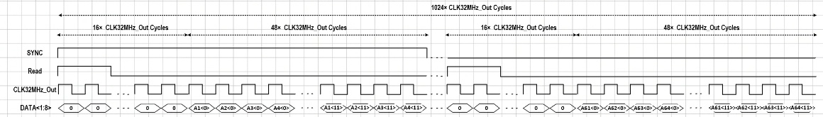
What happens in the background
Recording Related Pins
  Chip_Reset: We use this pin to reset the chip to a known state
  CLK32MHz_In: If we press start recording button, the FPGA sends this clock to the ASIC to start the recording
  FE_RESET: If we press reset amplifier button, the FPGA resets the amplifiers we should see very silent channels
  Amplifier Gain: Amplifier gain is set by a Serial Peripheral Interface (SPI will talk more about this later)
When recording starts: Chip will transmit these signals
  CLK32MHz_Out: Used by FPGA to readout the correct data
  Data<1:8>: Contains the recording data
    Each data line contains the information of 4 ADC (time multiplexed)
    One ADC → 16amps, then 1 Data → 64 amps.
  Read: Used to let the FPGA know that a new amplifier’s data is being streamed
  Sync: Used to let the FPGA know which amplifier’s data is being streamed

Slide 15
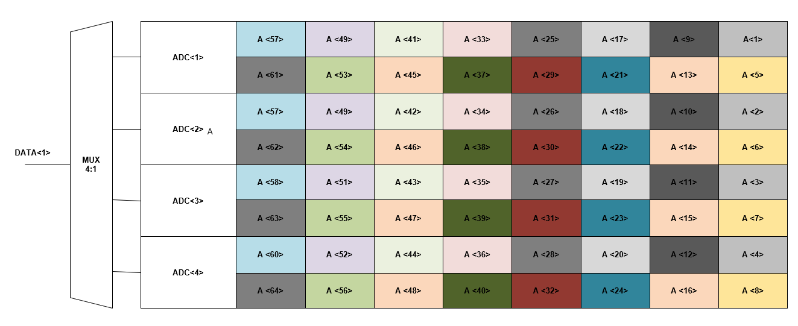
Communication Protocol
1 Frame = 1024 clock cycles
Within each frame, there is one Sync and 16 Read
Sync, signals when the FPGA should start streaming the data → aligns the channel map
Read signals a new amplifier is being streamed
  Within each Read period, DATA streams information about 4 amplifiers (from 4 different ADCs which share the same data line)
  They all have the same location in a group of 16

Slide 16
Communication Protocol
1 Frame = 1024 clock cycles
Within each frame, there is one Sync and 16 Read
Sync, signals when the FPGA should start streaming the data → aligns the channel map
Read signals a new amplifier is being streamed
  Within each Read period, DATA streams information about 4 amplifiers (from 4 different ADCs which share the same data line)
  They all have the same location in a group of 16

Slide 17

Communication Protocol
1 Frame = 1024 clock cycles
Within each frame, there is one Sync and 16 Read
Sync, signals when the FPGA should start streaming the data → aligns the channel map
Read signals a new amplifier is being streamed
  Within each Read period, DATA streams information about 4 amplifiers (from 4 different ADCs which share the same data line)
  They all have the same location in a group of 16

Slide 18
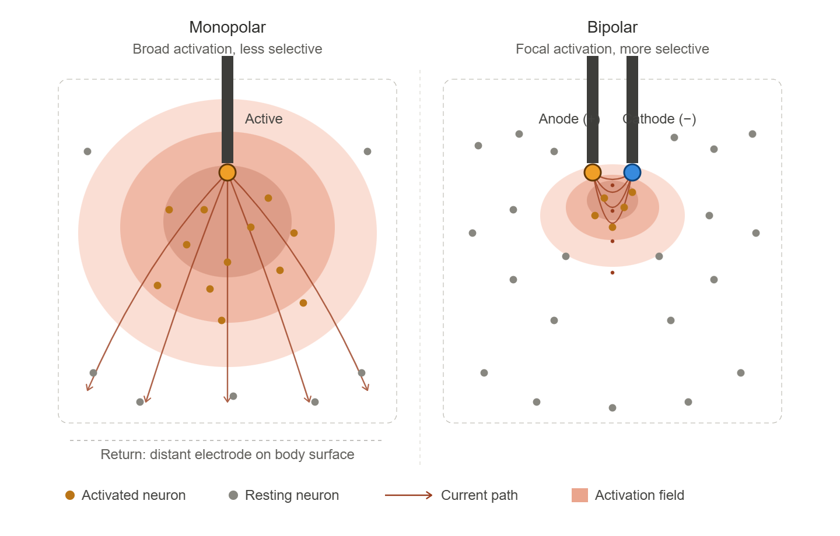
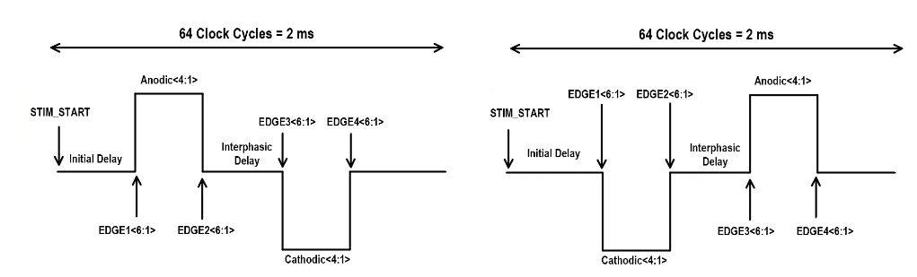
Stimulation Mode
Biphasic stimulation (monopolar/bipolar)
Fully programmable arbitrary waveform
±10V stimulation compliance
Passive charge balancing

Slide 19
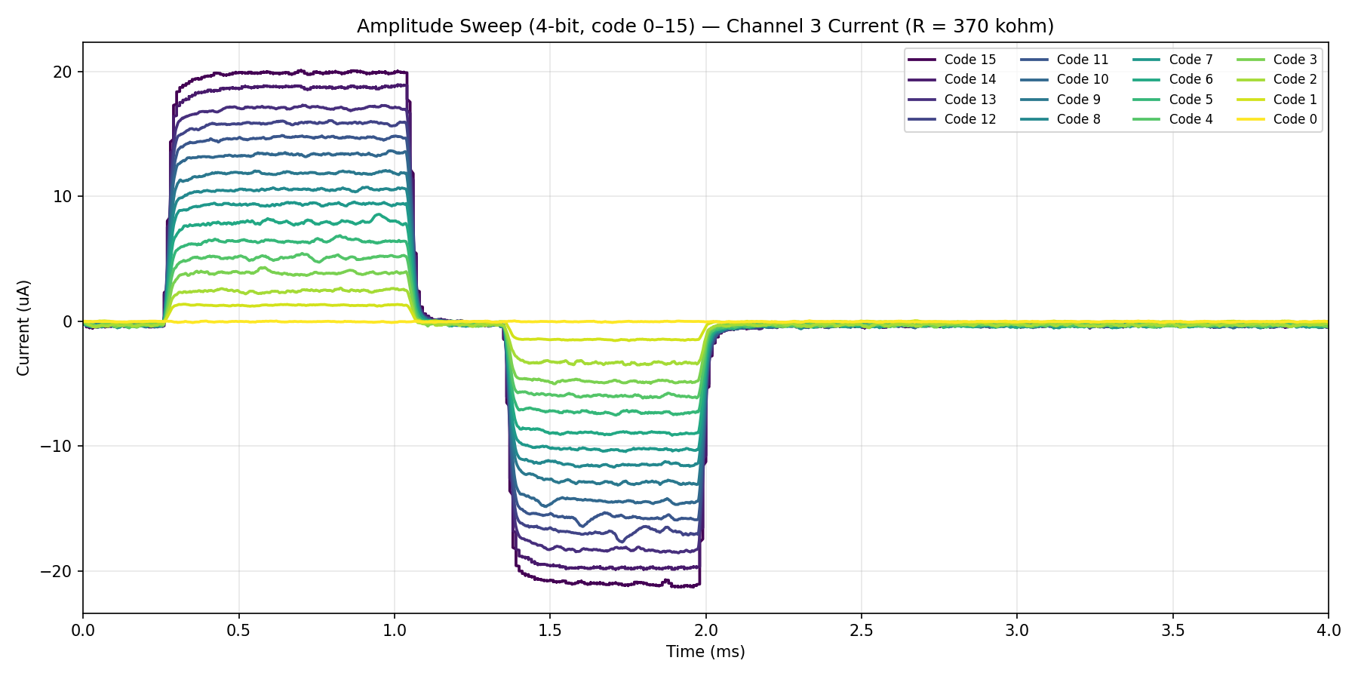
Stimulation Mode - How
Up to ~22.5µA (4-bit control) with a resolution of ~1.5 µA

Slide 20
Stimulation Mode - How
There are 64 stimulator in each side,
left and right

Slide 21
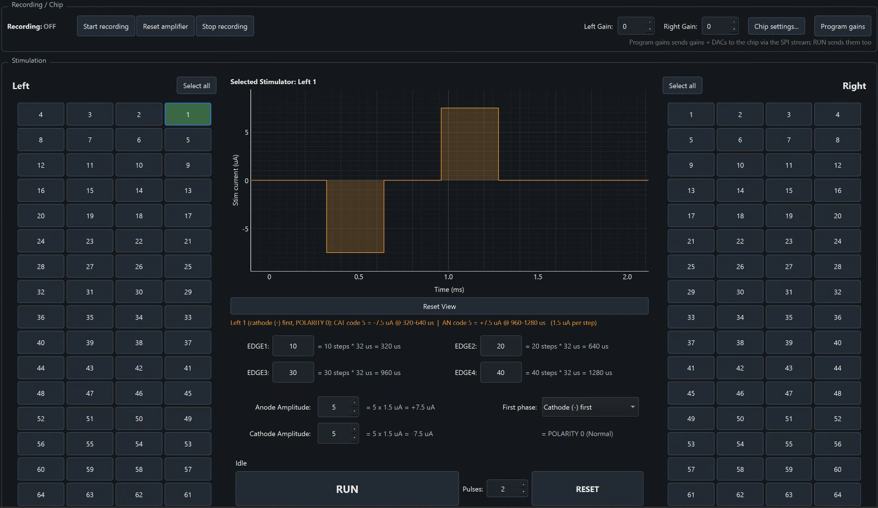
Stimulation Mode - How
There are 64 stimulator in each side,
left and right
Select the stimulator
  Fill the edge information based
  Fill the anode and cathode information
  Polarity
Stimulators can have different setting

Slide 22
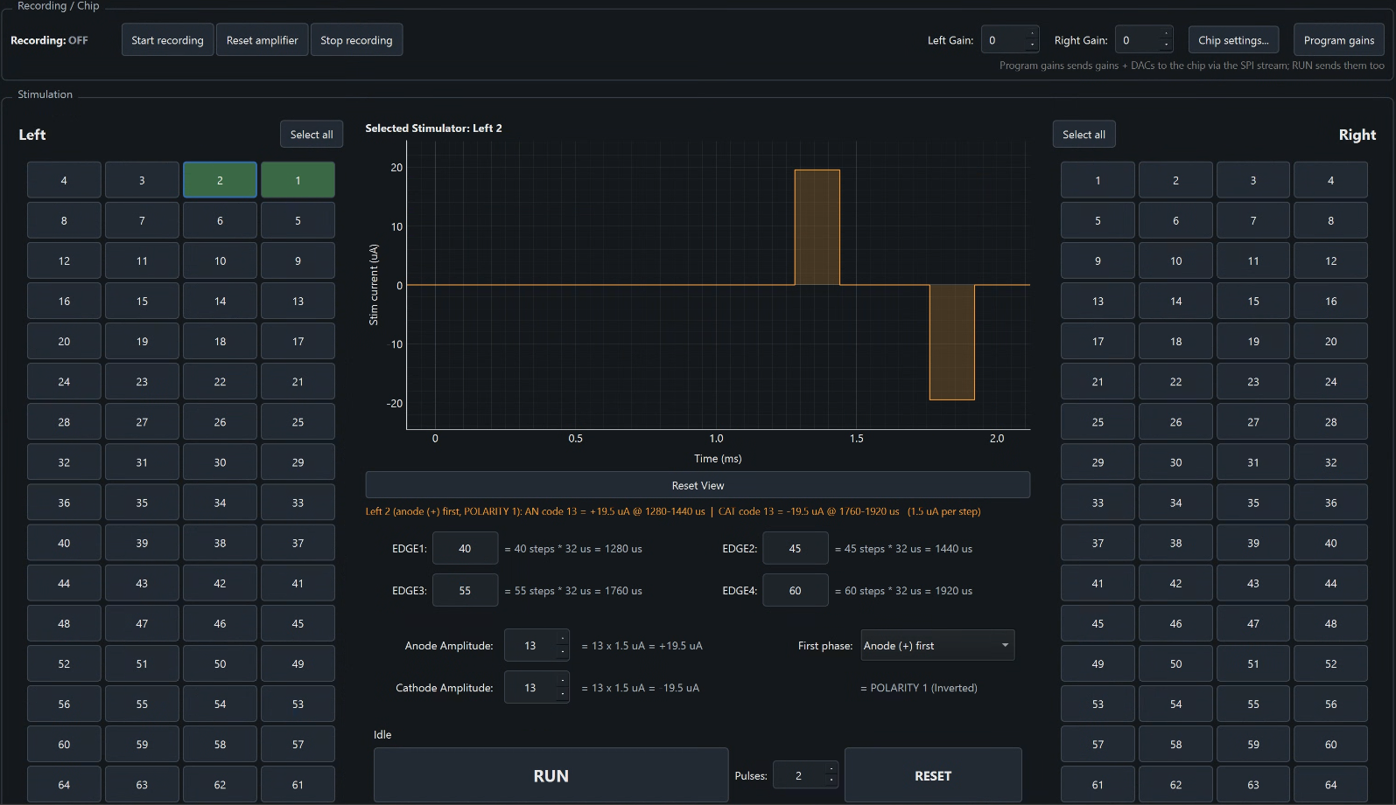
Stimulation Mode - How
There are 64 stimulator in each side,
left and right
Select the stimulator
  Fill the edge information based
  Fill the anode and cathode information
  Polarity
Stimulators can have different setting

Slide 23
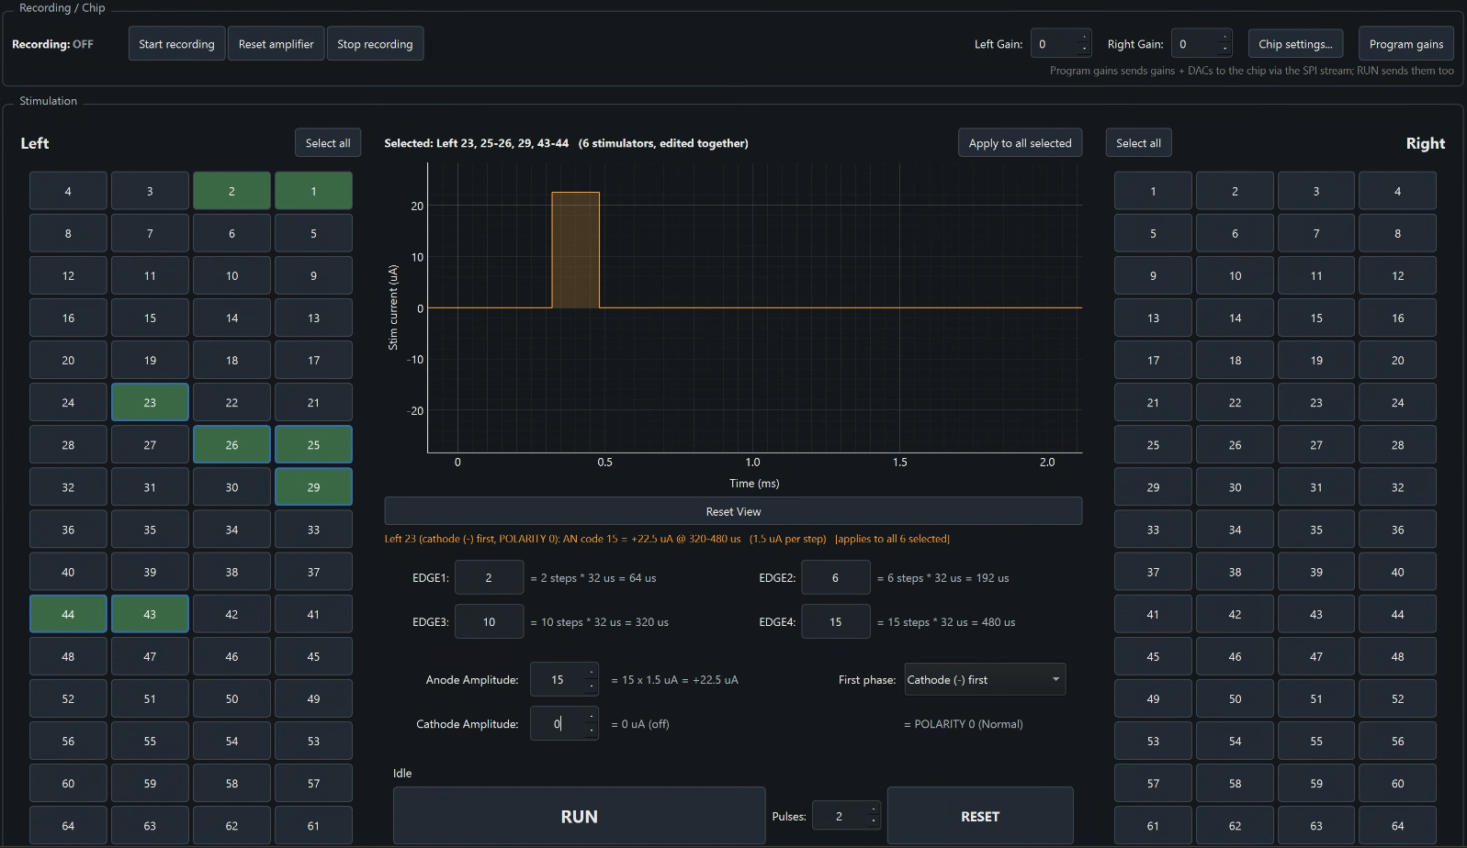
Stimulation Mode - How
There are 64 stimulator in each side,
left and right
Select the stimulator
  Fill the edge information based
  Fill the anode and cathode information
  Polarity
Stimulators can have different setting
Can program multiple of these stimulators at the same time

Slide 24
Stimulation Mode - How
There are 64 stimulator in each side,
left and right
Select the stimulator
  Fill the edge information based
  Fill the anode and cathode information
  Polarity
Stimulators can have different setting
Can program multiple of these stimulators at the same time
Last we select the number of pulses we want to send (1-254) and click RUN

Slide 25
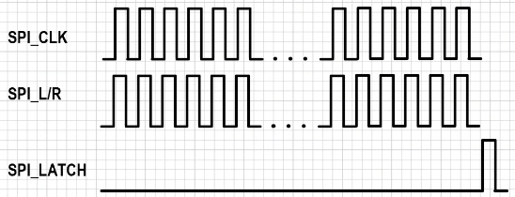
What happens in the background
Firstly, an SPI excel file is loaded to the FPGA which then sends the data to the ASIC
  The SPI has 4 data pins <CLK, L, R, LATCH>
  L and R contains information for the stimulators programming and the gain of the amplifiers.

Slide 26
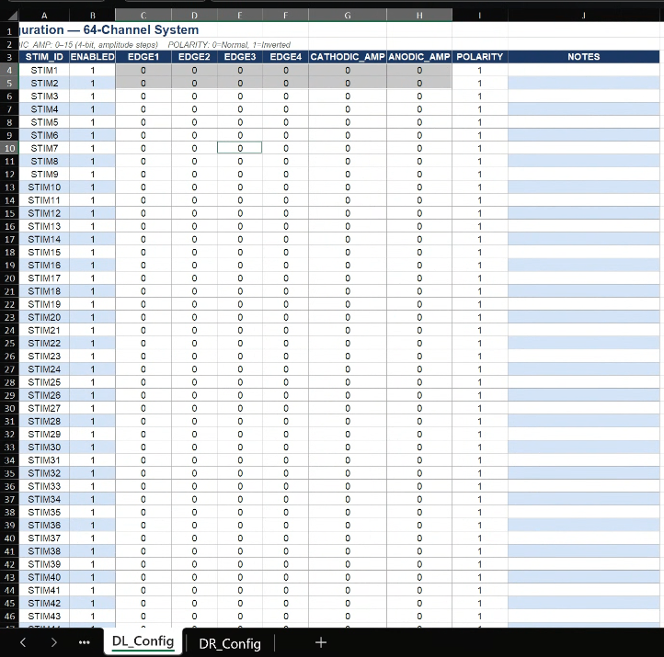
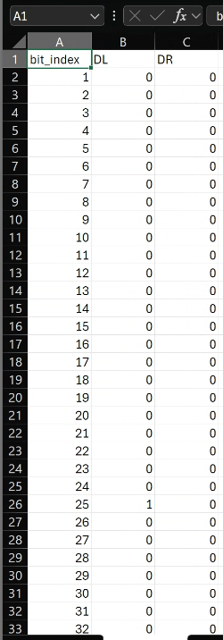
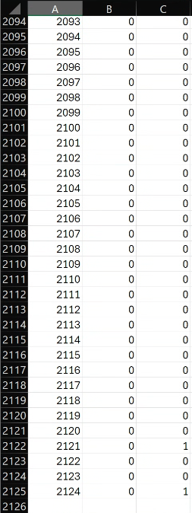
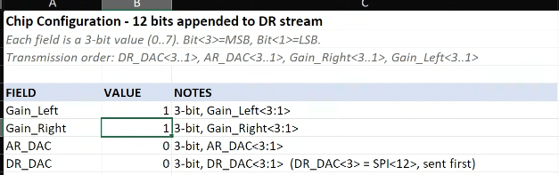
What happens in the background
Firstly, an SPI excel file is loaded to the FPGA which then sends the data to the ASIC
  The SPI has 4 data pins <CLK, L, R, LATCH>
  L and R contains information for the stimulators programming and the gain of the amplifiers.
  Another patch reads the data in these two excel files and generates the right SPI stream file that downloads to the FPGA
Gain Config
STIM Config
SPI Stream

Slide 27
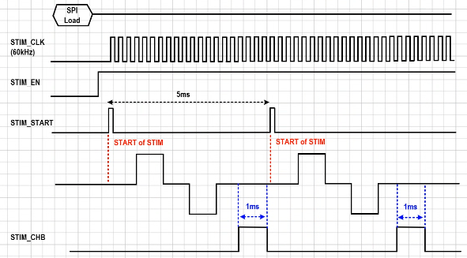
What happens in the background
Firstly, an SPI excel file is loaded to the FPGA which then sends the data to the ASIC
  The SPI has 4 data pins <CLK, L, R, LATCH>
  L and R contains information for the stimulators programming and the gain of the amplifiers.
  Another patch reads the data in these two excel files and generates the right SPI stream file that downloads to the FPGA
How does the stimulator start working?
  Firstly, we enable the stims via STIM_EN
  Then we send a short pulse to trigger the stims → STIM_START
  After 64 STIM_CLK cycles, we enable STIM_CHB which does the charge balancing

Slide 28
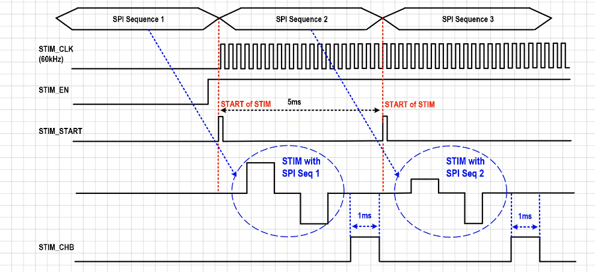
Different Stim patterns each cycle?
Firstly, an SPI excel file is loaded to the FPGA which then sends the data to the ASIC
  The SPI has 4 data pins <CLK, L, R, LATCH>
  L and R contains information for the stimulators programming and the gain of the amplifiers.
  Another patch reads the data in these two excel files and generates the right SPI stream file that downloads to the FPGA
How does the stimulator start working?
  Firstly, we enable the stims via STIM_EN
  Then we send a short pulse to trigger the stims → STIM_START
  After 64 STIM_CLK cycles, we enable STIM_CHB which does the charge balancing
Different stimulation sequence is possible as long as we can generate the timing diagram shown in the right

